Slide 1
An overview of blockchain
Zahra Aghaee

Slide 2
preface
Issues that led to the creation of the BlockChain

Slide 3
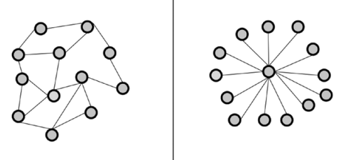
Two Types of Software Architecture
Centralized
components are located around and connected with one central component
Distributed
connected components without having any central element
Peer-to-peer networks
a special kind of distributed systems
consist of individual computers
share their computational resources to all other members of the network
without having any central point of coordination
The nodes in the network are equal.
Distributed Centralized

Slide 4
Distributed
A
Advantages
• Higher computing power
• Cost reduction
• Higher reliability
• Ability to grow naturally
Disadvantages
D
• Coordination overhead
• Communication overhead
• Dependency on networks
• Higher program complexity
• Security issues

Slide 5
Blockchain
Definition

Slide 6
Technical Definition
peer-to-peer
No central controller
Updatable via consensus
Power of decentralization
No central authority
distributed ledger
The data structure contains an orderly list of transactions
immutable
cryptographically secure
Non-repudiation
Data integrity
Data origin authentication
append-only
Blocks added to the blockchain can not be changed

Slide 7
Types of blockchain
Private
Public
Semi-private
Open only to
a consortium or group of individuals or organizations who have decided to share the ledger
among themselves
Not owned by anyone
Anyone can participate as a node
Bitcoin and Ethereum
Part of the blockchain is private and part of it is public

Slide 8
Elements of a Blockchain
Address
01
Unique identifiers
Denote senders and recipients
Public key or derived from a public key
Transaction
02
A transfer of value from one address to another
The transaction data structure usually consists of some logic of transfer of value, relevant rules, source and destination addresses, and other validation information
Block
03
Multiple transactions and other elements, such as the header, previous block hash, timestamp, and nonce.
Node
04
Performs various functions
Propose and validate transactions
Perform mining to facilitate consensus
Secure the blockchain

Slide 9
Block
P
Pointer to previous block’s hash
(hash pointer)
Unless it is a genesis block
Nonce
N
A number that is generated and used only once
Used in PoW consensus algorithms
T
Timestamp
Creation time of the block
Merkle root
M
Combined hash of the transactions in the block
Efficient verification of transactions

Slide 10
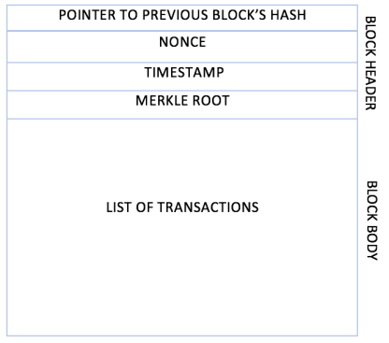
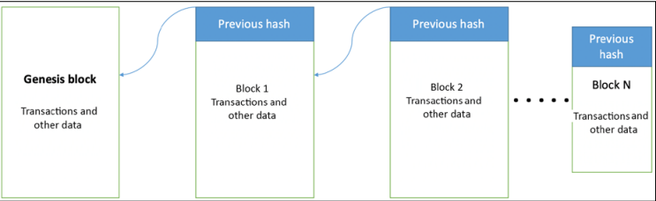
Block Blockchain

Slide 11
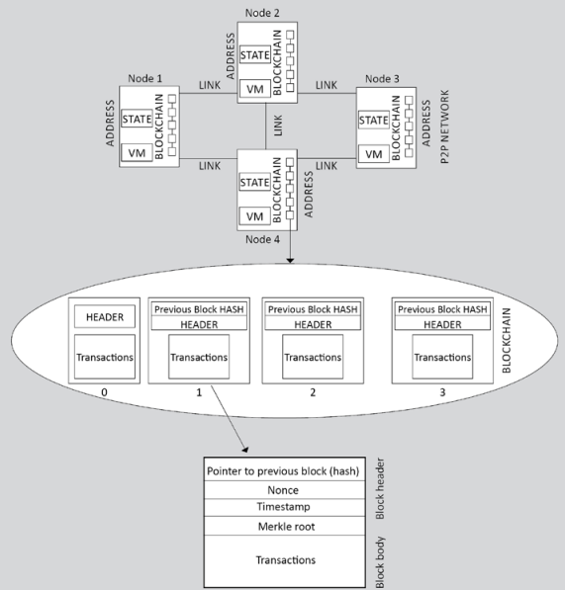
Node
Nodes are either miners who create new blocks and mint cryptocurrency (coins) or block signers who validate and digitally sign the transactions.

Slide 12
How blockchain works
01
02
03
Find new block
04
New block found
05
Add new block to the blockchain
Transaction is initiated
Transaction is validated and broadcast
Process of mining starts
Nodes called miners race to finalize the block
A miner solves a mathematical puzzle
Miner is rewarded
In each round, a random node gets to broadcast its block
Node starts
Digitally signing it with its private key
The newly created block is propagated to other peers
Peers also validate and execute the block
It now becomes part of the blockchain
Using data-dissemination protocols, such as Gossip protocol
Before broadcast verified to ensure that it is valid

Slide 13
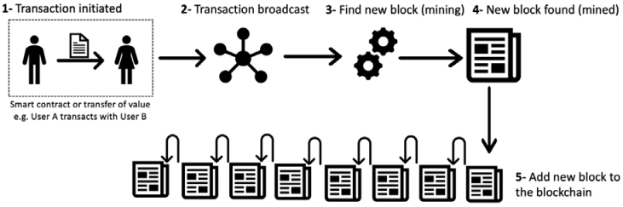
How a block is generated

Slide 14
Step1: Transaction is initiated

Slide 15
Hash
Hash Function
1
A hash function is a mathematical function:
input can be any string of any size
fixed-sized output
efficiently computable O(n)
A hash function H is said to be collision resistant if it is infeasible to find two values, x and y, such that x ≠ y, yet H(x) = H(y)
2
If we’re given the output of the hash function y = H(x), there’s no feasible way to figure out what the input, x, was
Similar input → different output
Cryptographic Hash Function
collision resistance
Hiding
puzzle friendliness
3
Easy to find hash but not very easy
Impossible to find by brute force

Slide 16
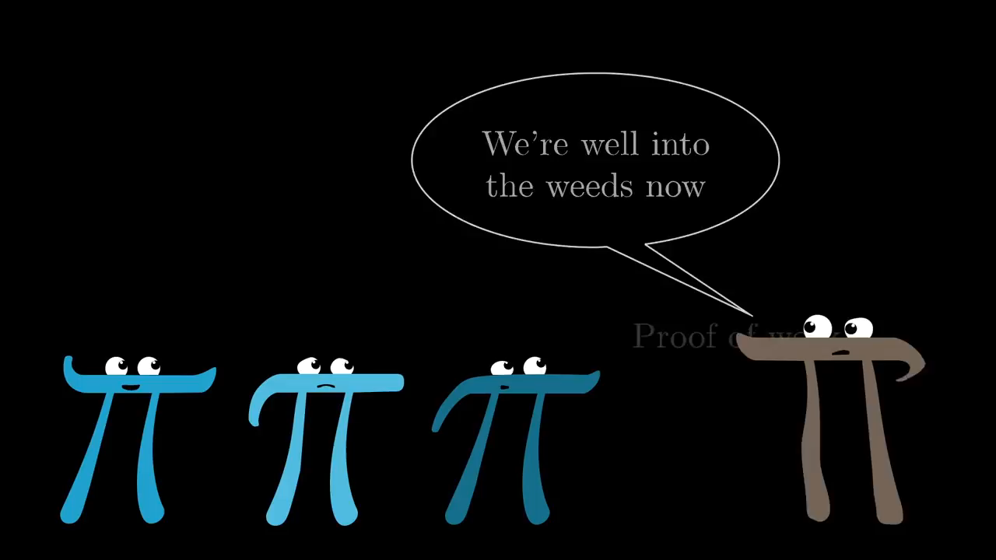

Slide 17
DIGITAL SIGNATURES
Signature
Signature
For individual
Only you can make your signature, but anyone who sees it can verify that it’s valid
cannot be used to indicate your agreement or endorsement of a different document
Verify
isValid := verify(pk, message, sig)
if sig is a valid signature for message under public key pk
Key
(sk, pk) := generateKeys(keysize)
takes a key size and generates a key pair
Sk is secret key
Pk is the public verification key
Given to everybody
Anyone with this key can verify your signature.
Extra
Extra
In bitcoin we need sig
Pk = username
Sk = password
Address = sha256(Pk)
Sk needs to be safe
Cold store
Sign
sig := sign(sk, message)
takes a message and a secret key
outputs a signature for message under sk

Slide 18
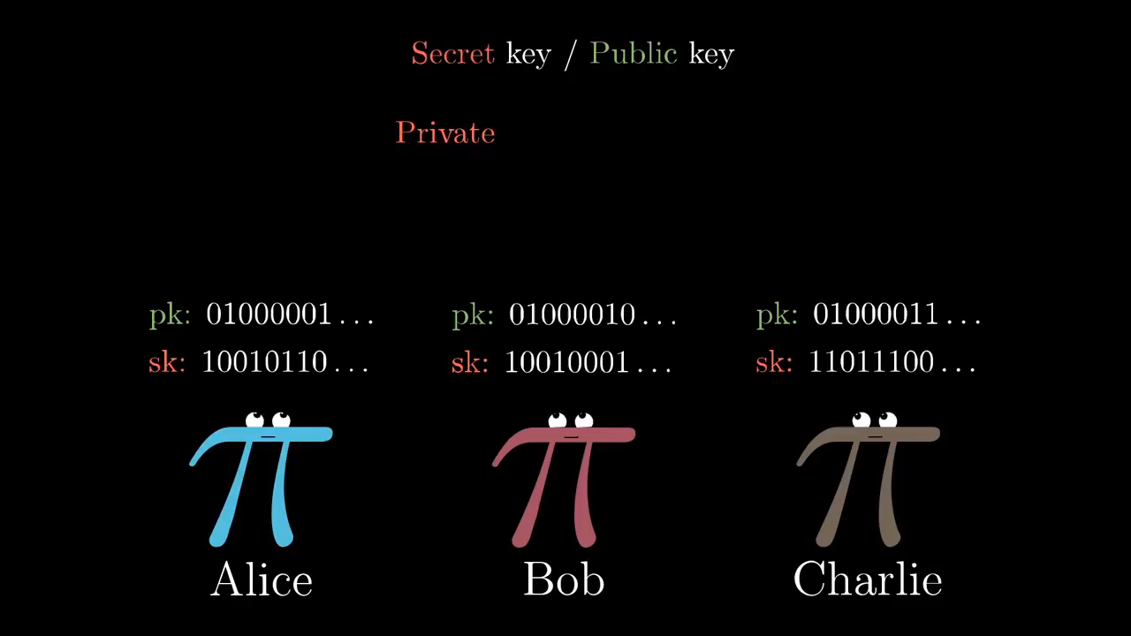

Slide 19
Step2: Transaction is validated and broadcast

Slide 20
Broadcast & verify
1
2
3
4
5
Each node executes several transactions.
Informs the other connected nodes.
They also keep these transactions.
Eventually something called a memory pool is created.
Each node checks the transactions it receives to make sure they are correct.

Slide 21
Step3: Find new block

Slide 22
Attacks
To be stolen
Not, Because they are signed and we need a private key
DOS
If one denies it, despite the many nodes, the others fix it while updating
Double Spend
Check in mem pool

Slide 23
Fork
Definition
types
Temporary forks
Soft forks
A fork is a condition that occurs when two different versions of the blockchain exist. It is acceptable in some conditions, and detrimental in a few others.
Temporary forks
Soft forks
Hard forks
Because of the distributed nature of Bitcoin, Forks can occur.
two nodes simultaneously announce a valid block.
Bitcoin network only by accepting the longest chain.
Forks can occur with the introduction of changes to the Bitcoin protocol.
The client that chooses not to upgrade to the latest version.
In this case, new and previous blocks are both acceptable.
Planned upgrades do not necessarily create forks because all users should have updated already.
Block
Block
Block
Hard fork
A hard fork, invalidates previously valid blocks and requires all users to upgrade.
New transaction types are sometimes added as a soft fork, and any changes such as block structure changes or major protocol changes result in a hard fork.
Block
Block
Block
Block
fork

Slide 24
Consensus
Consensus
Distributed consensus
Several nodes must be reached in consensus to add a block to the blockchain.
Consensus is a process of achieving agreement between distrusting nodes on the final state of data
This process of attaining agreement on a common state or value among multiple nodes despite the failure of some nodes is known as distributed consensus
?
Consensus mechanism
A consensus mechanism is a set of steps that are taken by most or all nodes in a blockchain to agree on a proposed state or value.

Slide 25
Requirements for a consensus mechanism
Agreement
All honest nodes decide on the same value
1
Requirements
Integrity
2
No node can make the decision more than once in a single consensus cycle
Validity
The value agreed upon by all honest nodes must be the same as the initial value proposed by at least one honest node
3
Fault tolerant
4
Run correctly in the presence of faulty or malicious nodes
Termination
All honest nodes terminate the execution of the consensus process and eventually reach a decision
5

Slide 26
Types of consensus mechanisms
Proof-based
In this model, a node proves that its block is correct and receives its reward. This model is used in public blockchains.
Proof of work (PoW)
Proof of stack (PoS)
Vote-based
Directional graph without round-based
In vote-based algorithms, members participating in the consensus process must be authenticated before the process can begin.
The transaction is approved collectively and participatory, and individual privileges will not affect this.
This partnership is formed by the exchange of messages between members across the network.
Blockchain has a linear structure
Blocks in a row and in order
Slowness
Cannot be run in parallel
In a directional graph without rounds, blocks are added in parallel to the chain.

Slide 27
PoW
PoW
Variants of PoW
The member who creates the block in each round is selected through a computational competition.
This computational competition is encrypted by solving a computational puzzle, and any member who solves it sooner than the others will have the authority to add the block to the chain.
The members who participate in this activity are called miner, and if the miners can add a new block to the chain by solving this puzzle, they will receive a certain amount of reward.
Doing proof-of-work calculations requires a lot of processing power.
The first condition in the competition also depends on the role of hardware power in this algorithm and the amount of energy consumption in this regard.

Slide 28
How PoW works
5
The resultant hash is checked against the target value, that is, the network difficulty
target value
3
Miners propose new blocks
New transactions are broadcast to all nodes on the network
1
6
If the resultant hash is less than the threshold value, then PoW is solved, otherwise, the
nonce is incremented and the node tries again. This process continues until a resultant
hash is found that is less than the threshold value
4
Miners concatenate and hash with the header of the previous block
2
Each node collects the transactions into a candidate block.

Slide 29
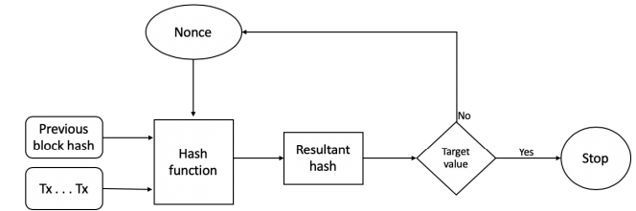
PoW

Slide 30
Problems
Problem
Sybil Attack
What if two people find the block at the same time?
The block with the longest chain is selected.
A person creates a large number of nodes to increase his chances.
This problem is solved with PoW. People are as lucky as they try. Each cpu has a chance.

Slide 31
Advantage & Disadvantage
Advantage
Disadvantage
Ensuring the security and integrity of the blockchain
Very rare fork
Plan and attack is very expensive
Requires heavy calculations
Adding a new block is time consuming
Need more resources to perform calculations

Slide 32
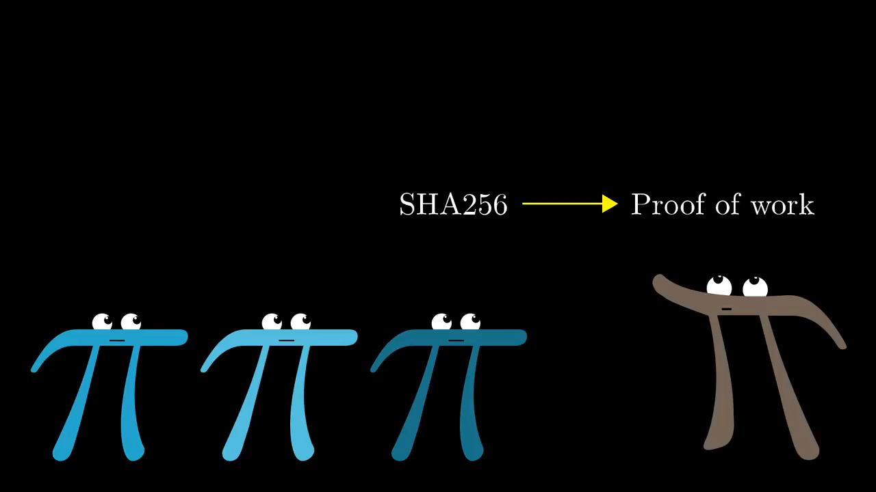

Slide 33
PoS
In this method, computing pools are created to confirm the block and add the block to the chain.
The network nodes join these pools without any priority and start operating.
Everyone gets a prize for the stack they share.
By connecting to the pool, everyone receives a template and tries to find the nonce, and if he finds it, he informs the pool and earns as much as his share.
With pool, many duplicate calculations are not performed and the calculations to confirm the new block are reduced.
If someone tries to cheat and confirms an invalid block, he will be fined and lose his shares.

Slide 34
Advantage & Disadvantage
Advantage
Disadvantage
Adding blocks to the chain is faster
Requires fewer resources for calculations
Fork happens more often
It's cheap to plan and attack

Slide 35
Benefits & limitations of blockchain
Scalability
Decentralization
Regulation
Immutability
Adoption
Transparency and trust
High availability
Relatively immature technology
Cost-saving
Privacy and confidentiality
Highly secure

Slide 36
Dr. Behjati

